Slide 1
Training For Home Visitors
Notes:
Welcome! Let's get to know you a little.
Raise your hand
- if this is the first OH training you’ve attended.
- if you have used CFK or seen it in action
-if you know as much about oral health as a dentist but you aren't sure how to get it into your home visits!
Alright! Well we are here to help!
I promise.....With CFK you don't have to be a dentist to be able to positively impact the oral health of the families you visit.

Slide 2
Goals for Today
Understand what causes cavities and how to prevent them.
Understand how CFK complements current Home Visitors program materials/curriculum.
Understand how to use CFK during home visits and parent gatherings.
Notes:
Goals for Today:
We want to make teaching oral health easy for you. By the end of this session we want you to:
- Understand what causes cavities and how to prevent them.
- Understand how the CFK resources are flexible and complement your program
- and be comfortable using them with both children and parents

Slide 3
What is Included in Cavity Free Kids
The CFK Resource for Home Visitors includes:
Resource with:
Visit Guides
Parent Practice Handouts
Family Engagement Tools
Quick Reference
Notes:
What is Included in Cavity Free Kids:
How is that possible when so many different home visitor programs are represented here today?
The secret is that YOU ALL should be listed as authors because we did a zillion focus groups across the state. We listened and wrote and listened again and developed the Home Visitor Resource that includes Guides for your visits.
And members of our pilot asked for a Grab and Go copy...that became your Quick Reference.
We will go more deeply into each of these today. They are yours to keep so bend corners or use the sticky notes to mark the things that will fit the families you see and fit your own style. You will use this at the end of our session today.
We want Cavity Free Kids not to be a HAVE to, but a WANT to.
But first we have to ask: what's the big deal about oral health?!?

Slide 4
Oral Health Facts
21 %
Percentage of 2-5 yr. olds with untreated tooth decay
54 %
Percentage of low income children with tooth decay
40 %
Percentage of Washington State children that start Kindergarten
with tooth decay
Notes:
Oral Health Facts:
Let’s look at some statistics.
Did you know that:
21% of children age 2-5 have untreated tooth decay (pause)
54% of children living at or below the poverty level have cavities (pause)
In Washington State, 40% of kindergartners have at least one cavity (pause) and nearly 15% of them have 7 or more decayed teeth. Those are pretty frightening statistics aren’t they?
They are a real concern because we know that poor oral health impacts more than those pretty smiles.
Kids with serious oral health problems may be in pain. The pain may make it hard for them to concentrate, follow directions, and learn. Oral health becomes an important part of school readiness.
The pain can also affect their social relationships because a child who is hurting may be cranky or withdrawn making them a less than ideal playmate. AND since young children may not be able to describe pain or may not even realize they are in pain --because they have learned to live with it--they may act out, seem uncooperative or become a behavioral problem.

Slide 5
The Children Behind the Statistics
Notes:
Let's look at real children behind the statistics.
What kind of oral health issues have you seen with parents and kids you have worked with?
Think of real families YOU may have known and Stand up if you:
· Have seen young children with cavities
· Have seen children with many stainless steel caps or crowns
· See young children or parents snacking on candy and soda pop
· Know of children who have had dental treatment under anesthesia
· Have heard parents say "They are just baby teeth“
· Wish NONE of the kids in our state had to suffer tooth decay.
You have just described why oral health education is so important.
The good news is: tooth decay is almost 100% preventable. It is much smarter to PREVENT oral health problems than it is to treat them. Because you work with the youngest of the young, you are in a position to really impact their oral health.

Slide 6
The 5 Basics of Oral Health
Baby Teeth Are Important
Water for Thirst
Tooth Healthy Foods
Brush, Floss, Swish
Going to the Dentist
Notes:
As Home Visitors you talk about a lot of difficult, personal issues with families. What are some of the challenges you face when talking about oral health?
You don't have to be an oral health expert to use CFK! We have taken all the oral health science and honed it down to 5 basics of oral health listed here
Then, for each of those basics, we created Home Visitor Guides, Parent Handouts, activities for parents and children to do together, and ideas to use at group sessions.
We wanted you to have resources for any circumstance.
Maybe mom of a 4 year old is worried that her child only wants to drink juice so you come prepared to show how elephants drink water. (bring prop)
Or Maybe one of your program goals is to encourage more physical activities for the parent and child to do together. Give them both a piece of pretend dental floss, put on some music and do the floss dance!
Or maybe when you talk about finger foods you will slip in a little about how carbohydrate foods stick on teeth and can cause cavities. (bring crackers) As we talk today you will see how smoothly oral health messages can fit with things you are already talking about!
We know Cavity Free Kids but YOU know your families. This is not a curriculum per se but a flexible resource to use WITH the other things you are already doing or what is required by your programs. We know there will be some times you will go to a visit planning to talk about oral health.........and other times when you need to be more spontaneous.
Think of using these resources as the Full Meal Deal or just a little bite!

Slide 7
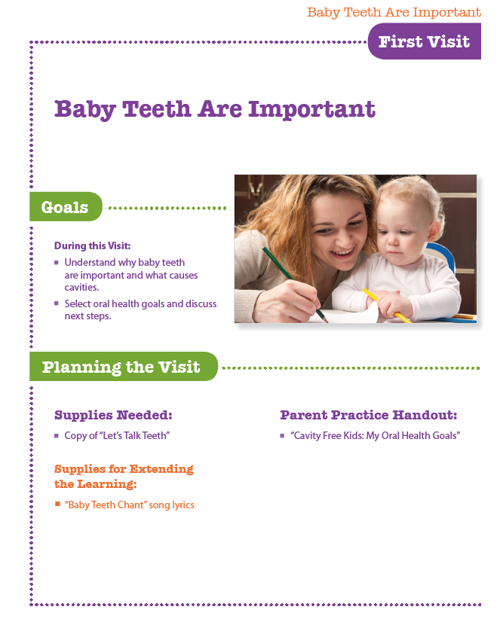
The First Visit
Establishing key knowledge about what causes cavities
Use Visit Guides in any order
Notes:
The First Visit:
We know home visiting is not a linear world! So “why” is one visit labeled the “first Visit”?
Well, this section establishes information about what causes cavities. There is no breakdown of ages because THIS is information that is relevant for pregnant women to grandpas! It opens up the subject and will help you help parents set goals.
After the first visit you can use the guides in any order that best fits the parent or child's needs.

Slide 8
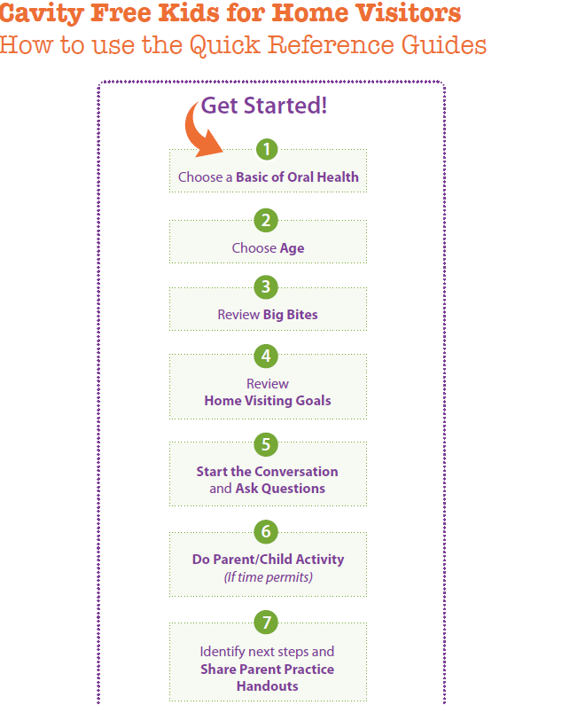
Planning a Visit
Notes:
Planning a Visit:
For each one of the Oral Health Basics there is what we call a Visit Guide. Come with me on a hypothetical visit to see how the resource might be used to plan a visit.
I was visiting Monica when I saw Monica's MOTHER- the grandma- pour some of her soda pop into little Jimmy’s sippy cup. I wanted to scream NOOO but of course I didn’t! So we finished up that visit and as I drove away I tried to think of how I could talk with her later about giving Jimmy something more healthy to drink.
I thought about those 5 Basic Topics that Tammy mentioned. I could talk about drinking more water or about sugar in foods but pop isn’t really food.....
Which would YOU choose?
OK, so I will look in my big book under water, Basic # 2. You can follow along with me as I think.
Next I will look at the child's age. How old should our pretend Jimmy with the sippy cup be?
Probably 2 so I will find the visit that fits the 6 to 36 month range.
The supply list gives me some hints about what I may need to bring--depending on what I decide to do.
I am more worried about How in the world am I going to approach the subject without offending her??? I look under Starting the Conversation for ideas.
What type of drinks do you offer your child? How do you think she would react to that? No, keep looking. Ah, the next one: what drinks do other people offer your child? Perfect we can talk about Monica's mother!
Now for the Parent or Child activity.
Hmmmm looking at how much sugar is in Coke might really be powerful. (READ) But I can just imagine Jimmy getting sugar all over the floor. What's another idea.
Read Potter the Otter. Jimmy loves books and we are encouraging early literacy. Perfect!
Now how about a handout. Which should I choose for Monica?
OK, I guess I will print out both. I can Xerox in black and white right from my book or I can go to the website and download a color copy.
Alright Monica, here I come! But................do your visits go so smoothly? Mine don't always.
Turns out when I got there she was mad at her boyfriend because he didn’t pay the light bill and she is sure the lights will be shut off.
Everybody is stressed and Monica is in no shape to sit calmly and read.....so I grab my Quick Guide that I keep in my purse to read the song lyrics and we teach Jimmy a new song.
Ever had a visit like that? It really shows you how flexible you can be with Cavity Free Kids. Maybe another time we will designate the whole visit to tooth healthy drinks and I will use the Visit Guide from start to finish...or I may choose to use another small piece of it.

Slide 9
1
Basics of Oral Health:
Baby Teeth Are Important
Notes:
Basic #1 Baby Teeth Are Important:
Ready to start looking at how the Visit Guides present oral health?
We will go thru each of the 5 Oral Health Basic concepts to give you an oral health update. We will use words or activities you might use to share that concept with parents or children. And we will point out how and where it is described in the book.
The first basic topic is: Baby Teeth are Important.
In this section children and parents will be learning what causes cavities and reasons to keep baby teeth healthy. This Basic emphasizes the importance of baby teeth in order to dispel the myth: “They’re just baby teeth; they’ll just fall out anyway”.

Slide 10
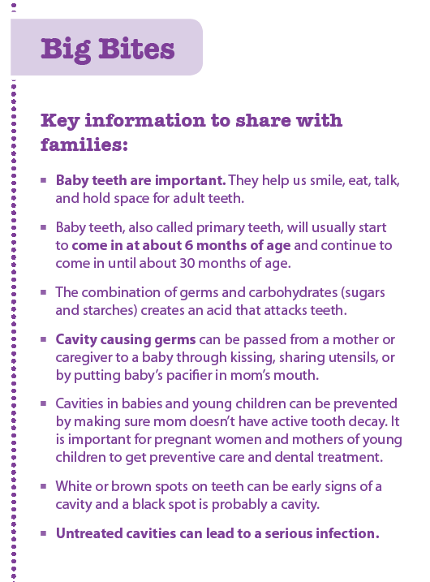
Big Bites: Baby Teeth Are Important
Notes:
Big Bites: Baby Teeth Are Important:
Turn to the page 13 titled “Big Bites”. The Big Bites are the key oral health concepts children and parents need to know for each of the 5 basics. They can also help clarify or jog the memory if there are questions after leaving training.
We’d like to show you a demonstration that illustrates why baby teeth are important. I need 3 volunteers to be teeth.
(volunteers step forward)
Look at these baby teeth--they start out clean and healthy, but what if this is a child who goes to bed with a bottle or one who is not having their teeth brushed every day. (Ask participants to turn paper over to brown side)
Oh, No! This mouth is full of decay. This tooth in the middle has become so decayed it has to be removed.. (Ask Center “tooth” to sit down)
What happens to the baby teeth that are left? Ask for ideas from audience. That’s right, they scrunch in to fill the space (Volunteers bend toward each other)
It is time for adult tooth to come in….What problems do you see now?
Yes, there is hardly room--it may come in crooked, be hard to clean. Baby teeth hold space for the permanent teeth & help shape the face as the child grows
…and look at her neighbors, they are full of decay... It hardly has a chance. Soon it will decay, too (Flip to colored side of paper so all brown paper faces the audience.) Learning how to care for baby teeth establishes good oral health habits and increases the likelihood of healthy teeth later in life. Thank you volunteers….
What if this child was missing several teeth?
Yes, nutrition will suffer & since the lips, tongues and teeth all work together to make sounds that make words, children with painful or missing teeth may develop speech problems.
.
Can you imagine doing this with parents at a Group Event? You can find this activity in the Family Engagement section on page 140.

Slide 11
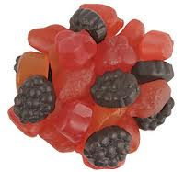
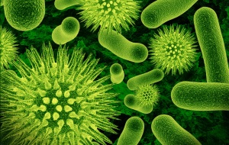
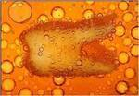
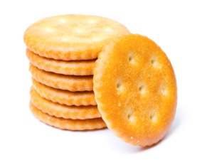
What Causes Cavities?
Germs + Food = Acid Attack
Notes:
What Causes Cavities?:
How many of you do group events? Can you imagine doing this with parents there? You can find this activity in the Family Engagement section on page 140.
YOU don't want to stay in lecture mode whether it is in a group or home visit, so you will find that CFK uses activities or demonstrations like the one you just saw…
Here’s another activity that dramatizes what causes cavities. Be thinking about how YOU might use it to engage parents.
What did your parents tell you causes cavities? Those are good answers but there is a little more to it than that. This equation is a simple way to remember the process:
Germs plus the food for the germs creates an acid that weakens the teeth.
Let’s look at the first part of the equation, the germs. Imagine that this vase is a child’s mouth. For this demonstration pepper will represent the germs
(Hold up vase that already has some pepper in it)
We all have germs in our mouths. But, did you know that those germs—bacteria--can be spread from tooth to tooth & from person to person, usually from mother to
child in the first 2 years of life?
If a mom has untreated cavities, she can spread her cavity- germs to her baby by sharing everyday items... like utensils (Ask audience member to add a little pepper) or by taking a sip from baby’s sippy cup and then giving it to baby (Add pepper) or cleaning the pacifier in your own mouth? We’ve all seen it! (Add pepper)
We know it’s not likely that moms will stop doing these things. That’s why it is so VERY important that mom understands that she needs to have regular dental care, even during pregnancy, and that if she keeps her mouth healthy & cavity free she will be less likely to pass germs to her baby, giving her little one a much better chance of avoiding cavities.
Now we have the germs but as we see from the equation there needs to be food for the germs to do their dirty work. What do you think their favorite foods are? (Audience responds) That’s right! Germs thrive on sugary foods….things like cake, candy, ice cream & soda pop… (A different audience member puts in a little sugar)
We used to just blame sugar for causing cavities but we now know more about those germs. New science has taught us that the germs like foods that are easy for them to break down --or digest. So we now know that the germs not only like sugars, but that they like any of the refined carbohydrates, or foods whose main ingredient is white flour. Things like; pretzels, chips, crackers, and white bread…foods we think of as starchy and a little sticky.
For our demonstration, baking soda represents food. (Another audience member puts in a little soda)

Slide 12
What do Acid Attacks do to Our Teeth?
Notes:
What do Acid Attacks do to Our Teeth?
When we have germs in our mouth and we eat or drink sugary or starchy foods & beverages, the germs eat them too. They use the carbohydrates to grow and make more germs then get rid of the rest as a waste product called acid. (Add vinegar to vase)
This acid flows on the teeth for 20 minutes! We call this the “Acid Attack”.
Let’s imagine that this is a baby who goes to bed with a bottle of milk or formula? One who sips on the bottle to get to sleep and every time he wakes during the night? (Add more baking soda and vinegar to vase a couple times)
Each time baby drinks more milk, there are 20 minutes more acid.
When this scenario is repeated over & over again those baby teeth end up sitting in acid all night long...getting weaker and softer and more susceptible to decay.
This is how children get cavities. And the same thing happens to adult teeth when we constantly sip on sugary drinks like juices, lattes or those extra large sodas from the corner mini-mart.
It’s not just the constant sipping that leads to decay, it can also happen by repeated snacking or grazing on crackers, cereal or other carbohydrates throughout the day.
By limiting snacking and having regularly scheduled meals you can reduce the # of acid attacks and give the teeth a chance to REST & REPAIR.
When those acid attacks have a chance to stop, our saliva which is full of protective minerals, flows on our teeth and strengthens or re-hardens them. That way the tooth is better protected & prepared for future acid attacks.

Slide 13
Using CFK
Start the conversation
Do the activity
Use parent practice handouts
Encourage behavior change
Close the visit
Notes:
Using CFK:
Now that you have seen us do this, think about how it might work for you in a real visit. Directions for this activity can be found in the Basic # 3 about Food. Flip through your book and call out the page number when you find instructions for this activity - page 50
The Guide is not meant to be a script per se--you will want to deliver the information in a way that works for you...and for the parent you are visiting.
How many of you work with pregnant women?
Even though this is designated for pregnant woman, you could do this at any time.
Let's do a partner activity. Working with a partner, imagine you were planning a visit to talk about food and teeth. Choose whichever age you usually work with and use the Guide to plan a visit from start to finish. Then we will have a couple groups report back.

Slide 14
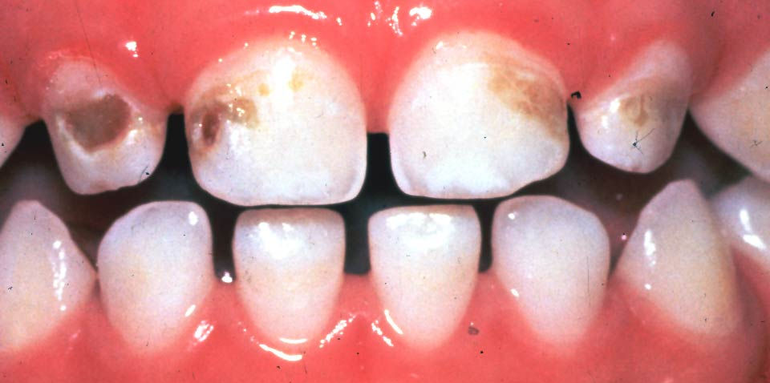
Early Childhood Caries
Cavities
White spots
Notes:
Early Childhood Caries:
Let’s look at the rest of the big bites for basic #1.
Another thing to know about tooth decay is that it is a progressive disease… That cavities start out small, like these white & brown spots, and will become more advanced, like the black spots, if nothing is done.
Left untreated the decay will continue to progress to the center of the tooth, the pulp, causing infections called abscesses.
This is a message for parents, not kids. Why do you think parents need to know this? (audience)
*will take kids to dentist sooner,
*will make the connection with the idea of germs in our mouth,
*will see dental disease as something that needs a dr or dentist care,
*encourage them to look in their child's mouth,
*will learn what to look for in their child's mouth, etc.

Slide 15
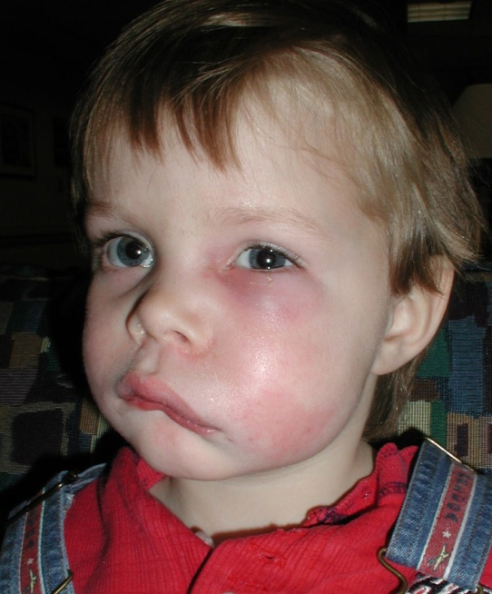
Abscess from Untreated Decay
Notes:
Abscess from Untreated Decay:
This little guy has an abscessed tooth that has not been treated. The infection has begun to spread throughout his face and will continue to spread to other parts of the body unless treatment is started immediately, within 24 hours. Children & adults can become so sick from this type of infection they can die! So you can see that “Wait & see” is NOT good advice when it comes to teeth.

Slide 16
2
Basics of Oral Health:
Water for Thirst
Notes:
Basic #2 is Water First for Thirst”
One of the reasons decay rates are increasing is because of all the sweetened drinks people sip on throughout the day.
Rather than sipping on sugary beverages why not choose the one drink that is not only healthy for your body but is great for your teeth too - water! It comes right out of your tap at home, for FREE.
And in many communities, tap water has fluoride which helps strengthen the teeth & make them more resistant to cavities.
Unfortunately, the popularity of bottled water has resulted in people avoiding fluoridated tap water, putting them at a greater risk of developing cavities. Most bottled water does NOT have fluoride. Check the label to be sure.
A rule of thumb to follow is- WATER FIRST FOR THIRST! Save soda & juice for special occasions.

Slide 17
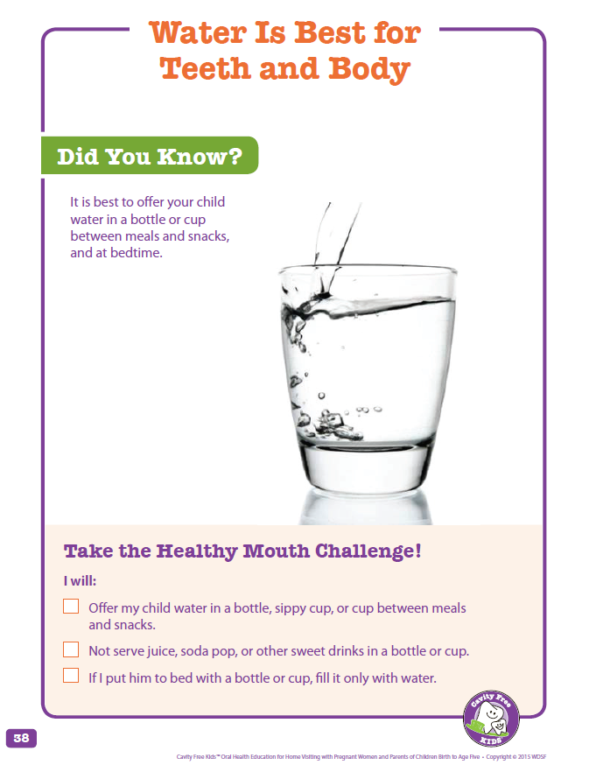
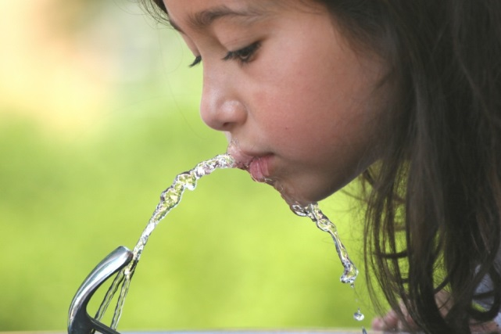
Parent Practice Handout
Notes:
Parent Practice Handout:
When we did our focus groups with home visitors they requested handouts to use during a discussion and to leave at the end of a visit. They wanted handouts that were not too word heavy. And, because we are looking at behavior change, CFK handouts have an action step.
To make it easy for you we have placed the handouts in two places--right by the visit where they are likely to be used and again in the Family Engagement section.
Find the Visit Guide for Water in the 6-36 month age and shout out the page number for the Parent Handout. 38/39
You might be wondering why we chose such a large age span. Using water as an example, a lot happens in the 6-36 month age range. It isn’t long before baby is weaned from bottle or breast and starts drinking what his parents drink! Work with your partner and discuss some creative ways you might use these handouts in your visits. Then we will hear from a couple groups.

Slide 18
3
Basics of Oral Health:
Tooth Healthy Foods
Notes:
Basic #3 Tooth Healthy Foods:
On to Basic #3 which takes us back to how we can change the cavity causing equation. We talked about HOW OFTEN we eat. Now we’ll look at WHAT we eat.

Slide 19
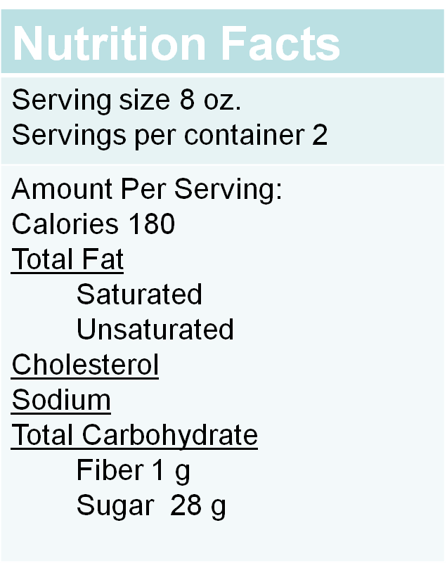
Parent Activity: Nutrition Facts Label
4 grams = 1 teaspoon
To calculate:
Find # grams of sugar
listed on label
Divide by 4
= # teaspoons of sugar
per serving
Notes:
Parent Activity: Nutrition Facts Label:
While looking thru the visit guide a minute ago you may have noticed the parent child activity listed called “guess the sugar”. We’d like to show you an example of how you can incorporate that activity during a home visit when you are discussing nutrition. The actual script is on page 146.
Let's say you are on a home visit & the parent tells you that their child doesn’t like milk and wonders if chocolate milk is a good alternative.
How can she determine if this is a good choice for his teeth? (audience—nutrition label, sugar content)
Raise your hand if you are familiar with how to read nutrition facts labels.
It looks as though most of you have had some experience with reading these so let’s just focus on the parts of the label that are SPECIFIC to oral health.
Since we already know that carbohydrates increase the risk for decay we will want to look at the heading Total Carbohydrates. Here it lists fiber & sugar.
It’s important to note that foods with a high fiber content are better for your teeth because they are harder for the germs to break down & create acid attacks.
But, I see everything is listed in grams…….who can tell me what a gram looks like? (audience)
It is hard to picture! But I do know that there are 4 grams in one teaspoon of sugar.
This label says 28 grams of sugar….divided by 4……how many spoons of sugar is that? (audience—7 teaspoons)
But that is only for one serving. This bottle says there are 2 servings per bottle. If my child is going to drink the entire bottle, I need to multiply 7 teaspoons by 2.
Ask audience for total teaspoons- There are 14 teaspoons in this bottle of chocolate milk!
So, IS chocolate milk a good alternative? Well..it does have protein, calcium and vitamin D but it also has a LOT of sugar! Maybe it would be best to save for special occasions.
Additional: Are you curious how much added sugar is recommended? The American Heart Association recommends:
Adult males 9 teaspoons; Adult females 6 teaspoons; Kids age 4-8 3 teaspoons

Slide 20
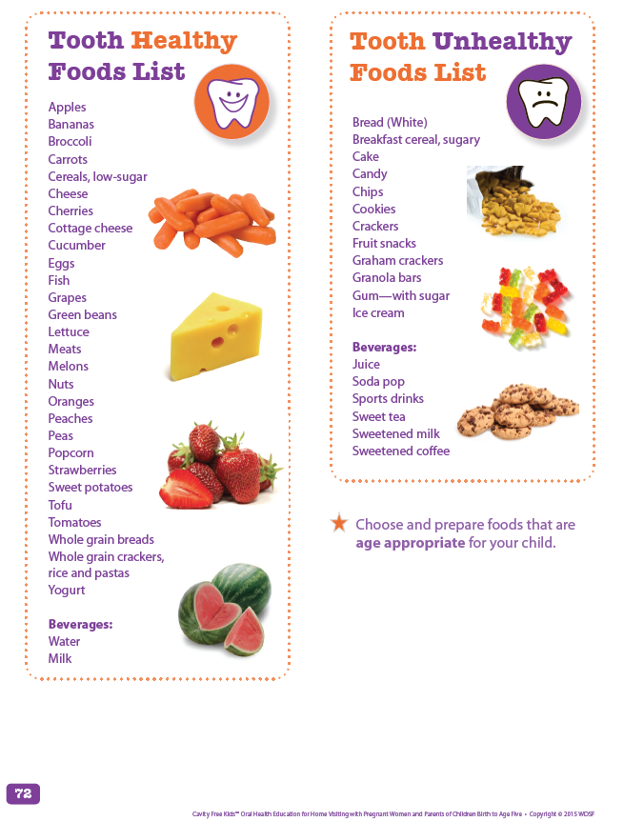
Tooth Healthy vs. Tooth Unhealthy
Notes:
Tooth Healthy vs. Tooth Unhealthy:
Bring cubes and bag of sugar for a day.
We know that sugar is not the ONLY cause of cavities but if we can help everyone be more aware of the sugar in food and drinks they may give their kids less. A powerful activity for parents is to guess--and then spoon or stack--the amount of sugar in a few common foods or drinks.
There are sugar cubes on your table--each one is about a teaspoon. Try to guess how much sugar is in 1 CAPRI SUN HAS about 28 grams or 6.5 – 7.5 TSP….TREETOP APPLE JUICE BOX=6.5 TSP
We are realistic and don't ask people to give up sugary or carbohydrate foods completely. We don't label foods as good or bad.
Instead, we talk about Tooth Healthy and Tooth UN Healthy foods. OR
Everyday Foods and Special Occasion Foods. Treat treats as treats.
Saving treats as treats is a message that preschool age kids can understand. On your tables are some examples that are tricky for a lot of people. When I come to you, hold it for everyone to see then decide which bag to put it in. (Raisins, sticky granola bars, fruit snacks, yogurt)
BH- How many of you work with preschool age, 3-5 year olds?
At that age I bet children are more involved in activities during the visit. If you work with 2 year olds you may want to peek in the preschool section and adapt some of the activities for a slightly younger child. And the reverse is true, too. There are some fun activities and songs in the younger age section that preschoolers might enjoy! Turn to this page 68 to see the directions for preschoolers to sort foods.

Slide 21
4
Basics of Oral Health:
Brush, Floss, Swish
Notes:
Basic #4 Brush, Floss, Swish:
Basic #4 deals with the oral health routines we can do every day to help prevent cavities.
Lets look again at the vase from the earlier acid attack demo. See the film that has formed on the sides of the vase (hold up). This film, plaque, is only removed by brushing & flossing. Unfortunately, we can never remove ALL of the germs/plaque, but we can get rid of enough of them to keep them under control.

Slide 22
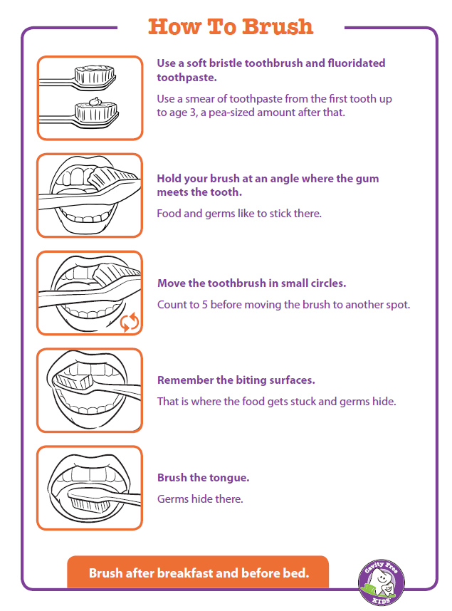
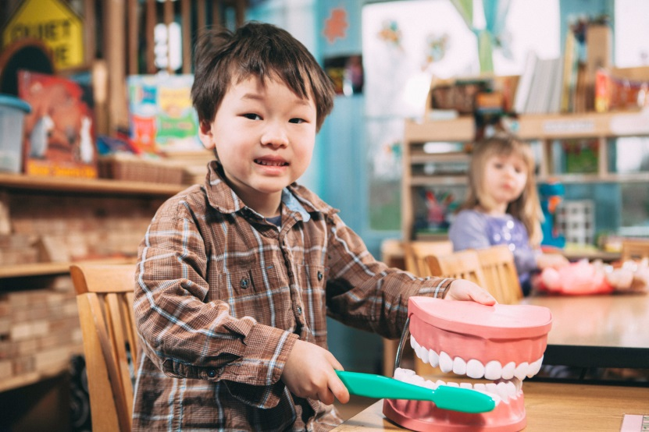
How to Brush
A smear when they appear and
at 3 the size of a pea!
Notes:
How to Brush:
Cleaning away the germs should start even before the baby has their first tooth. Simply wipe the gums & tongue with a soft cloth or gauze after feedings. Parents can even make this part of the bath time routine.
When that first little tooth comes in, it is time to introduce a small toothbrush. Some parents may feel more comfortable using the finger-tip brushes that can be found at various stores.
Everyone should brush their teeth for two minutes, two times a day, after breakfast and always before bed. Bedtime is the most important time to brush teeth so those germs & food particles don’t sit on the teeth all night making acid attacks.
You should always use a soft-bristled brush. The harder ones are much too stiff for your teeth & gums and can cause irritation.
And you should use fluoride toothpaste. But the amount you use is very different from what you see on commercials. You only need a smear of toothpaste when the first tooth appears and at 3; use the size of a pea.
It’s important to know that it’s the brush (or floss) that removes the plaque…not the toothpaste. But the paste is still very important because the fluoride in the paste helps protect the teeth.
Let’s go over the basic brushing technique…
Bristles pointed at an angle to the gums, use brush in circular (teeney tiny tickly circles) motions to brush one tooth at a time. Brush the outsides, insides, and biting surfaces. Top & bottom teeth. And don’t forget the tongue! Brushing the germs off the tongue helps get rid of bad breath. When you are done brushing there is NO NEED to rinse.
We want the fluoride in the paste to remain in the mouth to prevent decay.
While it’s great that kids try to brush on their own, adults should assist children with brushing until they are about 8 years old. And they should try to make brushing FUN! Play music or use timers…whatever appeals to their child.
Toothbrushes should be replaced about every 3 months, when you’ve been sick, or when it looks worn or frayed.
Have any of you gone to a home visit and found that family members are sharing a brush? It’s important to NEVER share a toothbrush...even with a family member because you would be sharing germs! You may be able to get toothbrushes donated by your own dentist, local dental society, or even local non-profit organizations.

Slide 23
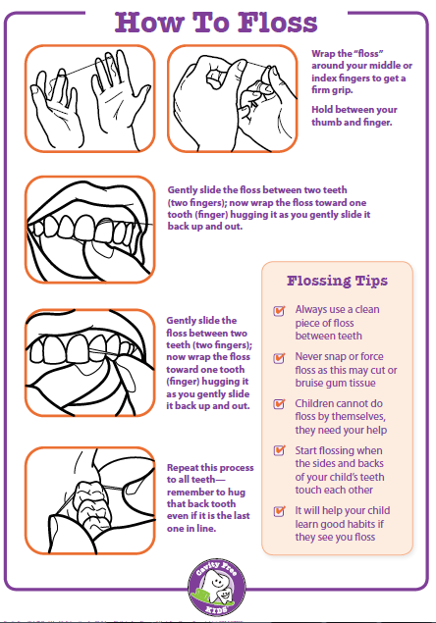
How to Floss
Notes:
How to Floss:
Flossing removes plaque and food debris that sticks between the teeth in places your brush can’t reach.
Flossing should be started when kid’s teeth begin to touch and just like with brushing, parents need to help. Young children just don’t have the coordination to do it on their own. Adults may find it hard to get their big fingers in a child’s tiny mouth so they can use a floss holder or floss aid to reach those back teeth.
You each have a piece of "floss" at your table. Choose a partner; one of you will be the home visitor and the other a parent.
Using the directions on page 81, pretend you are on a home visit & you are teaching mom how to floss.
The most important thing to remember about flossing is to GENTLY wrap the floss towards the side of the tooth, never using pressure or forcing the floss between the teeth. This could result in cutting or bruising that little point of gum tissue between the teeth which hurts & makes the gums bleed!

Slide 24
Swish and Swallow
Swish with water after eating or snacking when you can’t brush
Not a substitute for brushing
Stops the acid attack
Notes:
Swish and Swallow:
Swish & swallowing is great for those times in between brushings.
Swish & swallow is not a substitute for brushing & flossing but should be used in ADDITION to brushing & flossing because it does not remove the germs but can help to wash away the food that is stuck on the teeth & it helps to stop acid attacks.
Simply take a gulp of water & vigorously swish it around the mouth…then swallow (or spit it out).

Slide 25
Fluoride Helps Prevent Tooth Decay
Fluoride:
A natural mineral that helps prevent cavities
Fluoride Sources:
Tap water in many communities
Fluoride varnish, rinse, gel, toothpaste, drops and pills
Visit: www.ilikemyteeth.org
Notes:
Fluoride Helps Prevent Tooth Decay:
Since many parents may have questions or MISCONCEPTIONS about fluoride we have included a parent practice handout on page 128 to help answer questions. Or you can visit www.ilikemyteeth.org for more information. We encourage you to read up on the safety & efficacy of fluoride so you can be prepared for questions.
Above all, it is NOT our job to convince people to use fluoride but to inform them of the benefits.

Slide 26
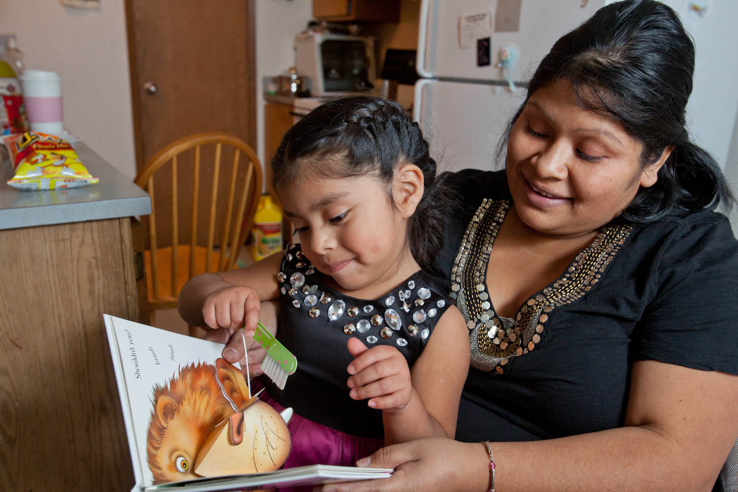
Oral Health Fits Other Parenting Issues
Notes:
Oral Health Fits Other Parenting Issues:
Once you are comfortable with the oral health messages you will find that they fit so well with other parenting issues. Instead of doing a whole visit dedicated to teeth you might sneak it in to other conversations. We saw how oral health messages fit perfectly with nutrition. You are the experts!
How would you challenge yourself to bring oral health in when you are talking about: Safety, the temper tantrum while standing in line at the dollar store, potty training.

Slide 27
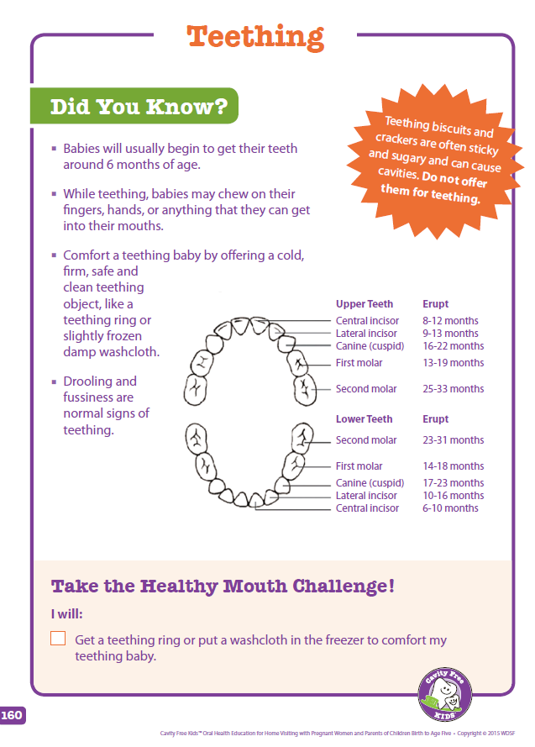
Little Bites
More Information on:
Teething
Lift the Lip
Fluoride
Accidents
Sealants
Notes:
Little Bites:
There is a place in your book called Little Bites that gives you information about some other topics not included in the big 5. This starts on page 161.

Slide 28
5
Basics of Oral Health:
Going to the Dentist
Notes:
Basic #5 Going to the Dentist:
Even with everything we can do at home to help prevent cavities it is essential to have regular dental care.
Regular visits to the dentist are important for every child (& adult) because changes in teeth can happen quickly.
A dentist not only treats dental problems but helps prevent them as well.
Ideally, every family will have a dentist that they visit regularly.

Slide 29
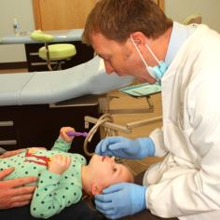
Visiting the Dentist
First Visit, First Birthday
Regular checkups – catch early decay and make teeth stronger
Treatment – important to follow up
Notes:
Visiting the Dentist:
It is recommended that children to have their “1st visit by the 1st birthday”. This may be done at a dental office or by a medical provider. The 1st visit is quick & easy. They may count the child’s teeth, look for early signs of tooth decay and talk with parents about how to care for the child’s teeth at home. They may also apply a fluoride to help prevent cavities.
Many offices are now using fluoride varnish. It is simply painted on the teeth to provide a long lasting protection.
Besides giving information to parents, there are activities especially in the preschool section that help the child get comfortable about going to the dentist. (Find the page in the Dentist section that has a pretend time for preschoolers)

Slide 30
Connecting Families to Care
Access to Baby and Childhood Dentistry (ABCD)
Private Insurance
Notes:
Connecting Families to Care:
Our goal is that every child will have a dental home. The good news is that in Washington State this can be a very achievable goal.
Every child who is Medicaid eligible can be connected to a dentist through the ABCD program. Have you heard of this?
ABCD is the Access to Baby & Childhood Dentistry program. It is for children ages birth to up to their sixth birthday who are on Medicaid (Provider One). The ABCD program will help connect families to a dentist in their area who has received special training on how provide dental care to young children. Every county in our state has an ABCD coordinator.
(We are providing you with a list today….? Check out the website…?)
Privately insured families should be encouraged to check their own plans to find a dental home.
(If they ask, access for adult care is not as easy—children and pregnant women have become the focus in our state)

Slide 31
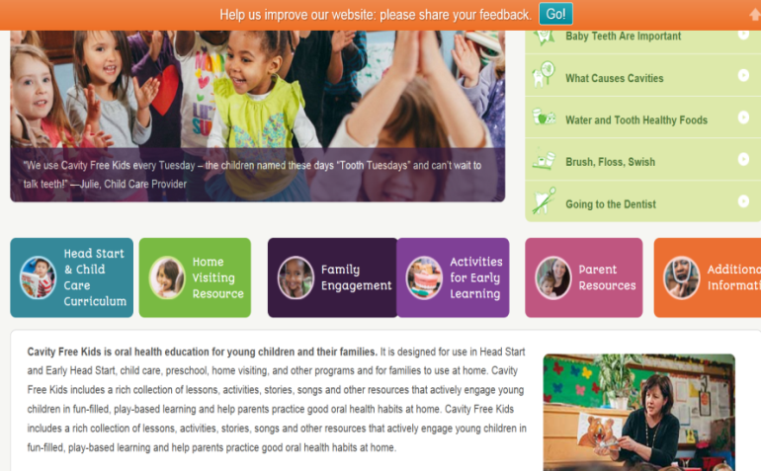
Family Engagement
Notes:
Family Engagement:
How many of you hold Group sessions around oral health?(share)
You can tell that we like to make OH a little silly and fun. Group activities and more are found in the Family Engagement section beginning on p 160.
You will also find FAQ’s and more ideas for conversation starters.
Between visits what other ways to you communicate with parents?
Newsletter ? Emails? How about including a CFK corner?
The “Information Bites” begin on page 163 and are short messages ready for you to use.
The QUICK REFERENCE is your grab & go version. It refers back to the big book or you can use it on its own to have the oral health information right at your fingertips.

Slide 32
REFLECTION
How will CFK fit in MY home visits?
YOU can make a difference
in the
health of families!
Notes:
Reflection:
You will be/have gotten tons of information during this summit. so let's end this session by reflecting on how CFK will be useful. Use your sticky notes or look back at the book and identify some things you might use in your home visits. Complete this page.
Reflection Page:
List a basic topic, activity, guide or handout that
will meet the needs of the parents I visit ________________________
fits the needs of a child/children I visit___________________________
fits my home visit style well _________________________________
I might use on my next home visit ____________________________
Report back

Slide 33
For a Lifetime of Good Oral Health
CFK website: www.cavityfreekids.org
Notes:
For a Lifetime of Good Oral Health:
The Cavity Free Kids website will be an additional resource for you. Be sure to go there to register and look around. If you have questions or need technical support, contact Karri is in the HV Resource.
Let’s summarize today’s training with a little quiz:
Raise your hand if you know the answer (Call on people randomly—ask for SHORT answers):
Name one tooth healthy drink. (water)
What is the difference between the Quick Reference Guide and the Home Visitor Guide?
What is a goal of using Parent Handouts?
Why so we call this a Resource not a Curriculum?
What are some ways to make brushing more fun? (songs, timers)
How many teaspoons in 16 grams of sugar? (16 divided by 4=4)
Which is better for teeth: 100% apple juice or an apple? (apple)
Where can you find more CFK activities & information? (website)
Any questions…comments? Thank You!!
Feedback forms

